Slide 1


Crime Prediction Model
Suspects
Miranda M., Brittney W., Zach P.
Notes:
Brittney

Slide 2
Table of Contents
Introduction/Background
Technologies Used
Data Cleaning Process
Data Observations
Pre-Optimized Model Results
Optimized Model Results
Conclusions
Implications/Limitations
Notes:
Brittney

Slide 3
Introduction/Background
According to the Brennan Center for Justice at NYU Law, predictive policing a method of “using algorithms to analyze massive amount of information in order to predict and help prevent potential future crimes”.
The Los Angeles Police Department (LAPD) was the first agency to use predictive policing models when they partnered with federal agencies in 2008.
The following states actively use predictive policing models:
California
Washington
South Carolina
Arizona
Tennessee
Illinois
New York
The NIBRS(National Incident Based Reporting System) is a subset of the Uniform Crime Reporting (UCR) Program. All incidents of crime are reported here. The data is compiled, cleaned, stored, and made available to the public and law enforcement agencies for the purposes of analysis.
Notes:
Brittney

Slide 4
Technologies Uses
PostgreSQL/psycopg2 | We created a connection to the PostgreSQL database to extract the data from
Pandas | To manipulate data within dataframes
zipfile | Used to have Pandas read a zipped file. This is needed when the file size is too large for Jupyter Notebook to handle.
scikit-learn | Used to preprocess the data, train the data, perform the Random Forest Classifier model, and display the confusion matrix and classification report
Jupyter Notebook | Used for creating code, visualizations, and deploying machine learning models
Tableau Public | Used to create the visualizations of the data
City of Charlotte Data Portal | Houses data for CMPD and other city/county agencies
Notes:
ZACH

Slide 5
Data Cleaning Methods
Either used the zipfile reader library or connect to PostGreSQL to extract the data.
Turned it into a DataFrame.
Iterated through the DataFrame to locate the null values and drop them from the data set.
Dropped unnecessary features.
Filtered the DataFrame to decrease the amount of information.
Mapped subcategories in the “CLEARANCE STATUS” column.
Created function to categorize crimes based on if classified as “violent” or “nonviolent”.
Notes:
ZACH

Slide 6
Data Observations
Notes:
Miranda

Slide 7


01
Total Count of Crimes based on NIBRS Categories
Looking at the total count of crimes based on NIBRS Categories
Notes:
Miranda

Slide 8
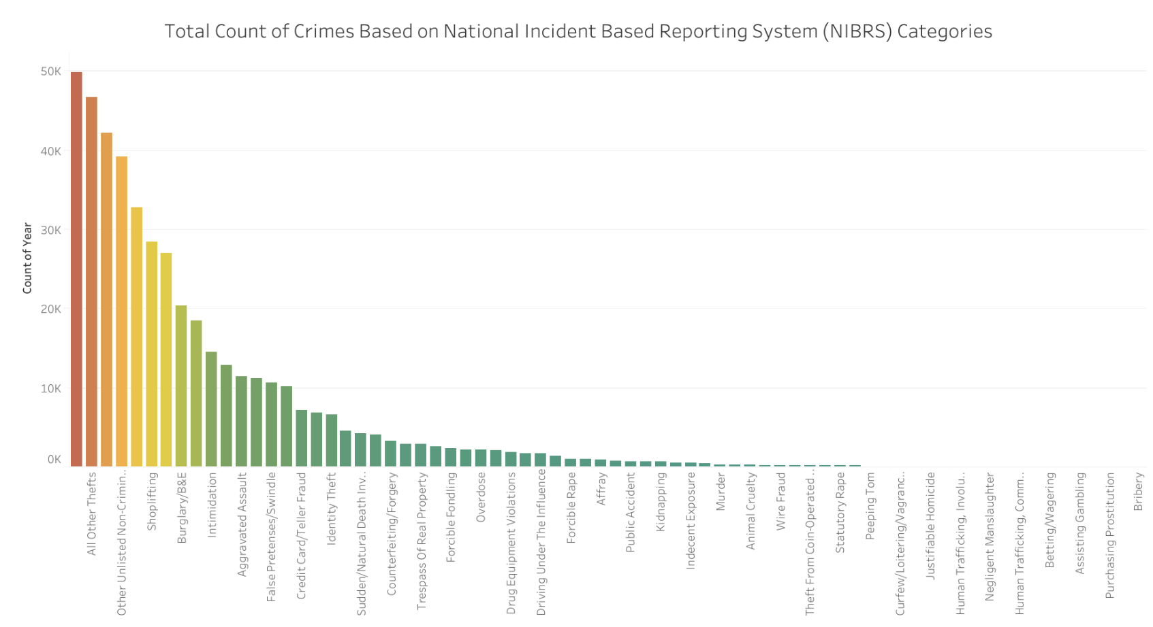
Click Here to View Full Dashboard
Notes:
Miranda

Slide 9
02
Violent vs.
Nonviolent Crimes: Locations
Comparing the number of violent vs. nonviolent crimes based on the type of location.
Notes:
Miranda

Slide 10
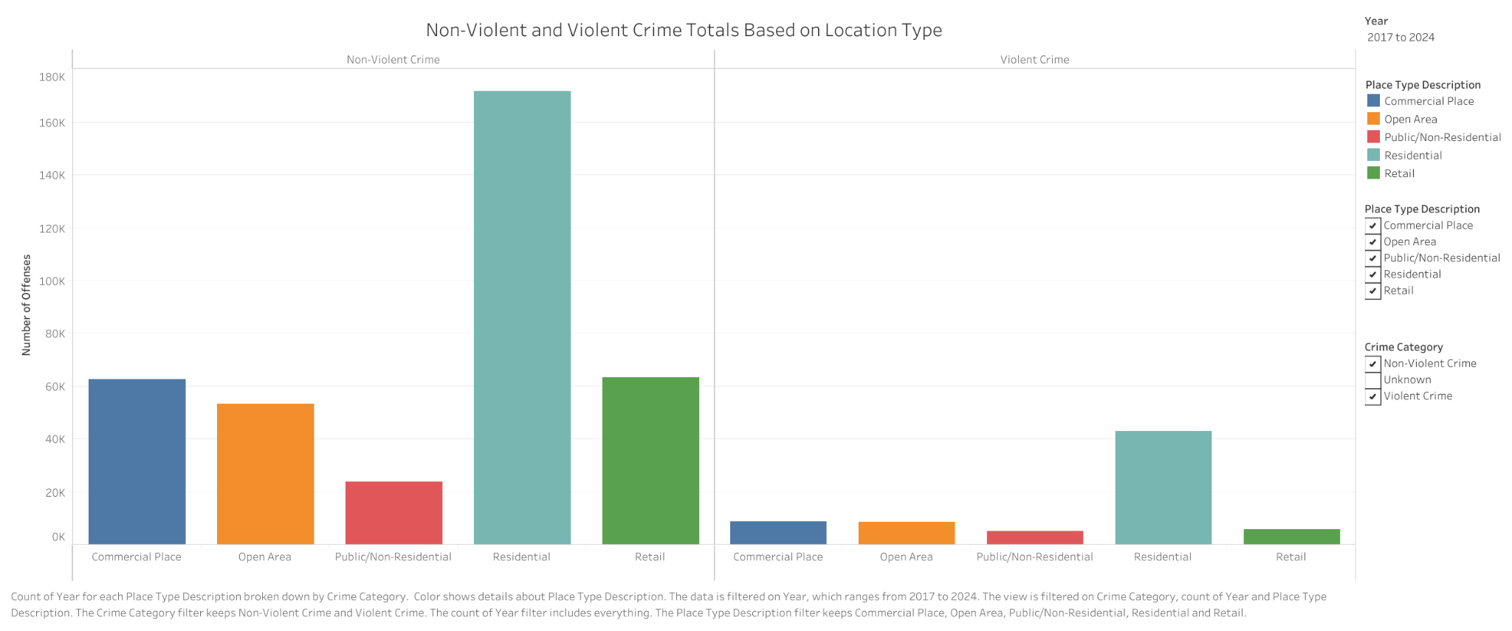
Click Here to View Full Dashboard
Notes:
Miranda

Slide 11
03
Monthly Trends
for Violent and NonViolent Crimes
Comparing the number of violent vs. nonviolent crimes per month in a given year.
Notes:
Miranda

Slide 12
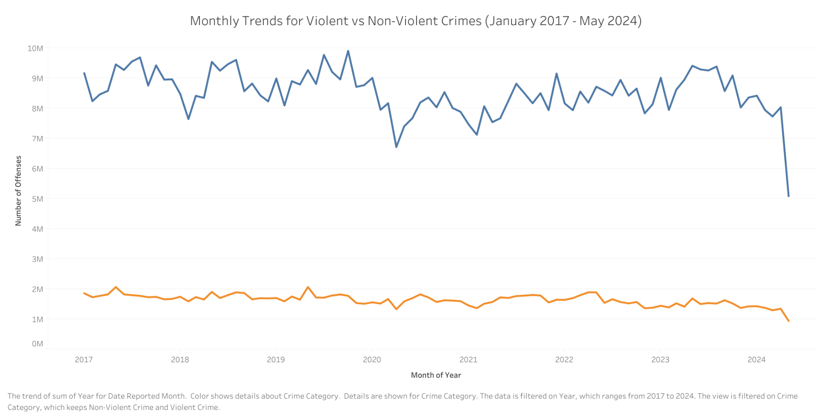
Click Here to View Full Dashboard
Notes:
Miranda

Slide 13
04
Yearly Trends for Top 10 Crimes for Charlotte, NC
Observing the Yearly Trends for the Top 10 Crimes for Charlotte, NC from 2017-2024
Notes:
Miranda

Slide 14
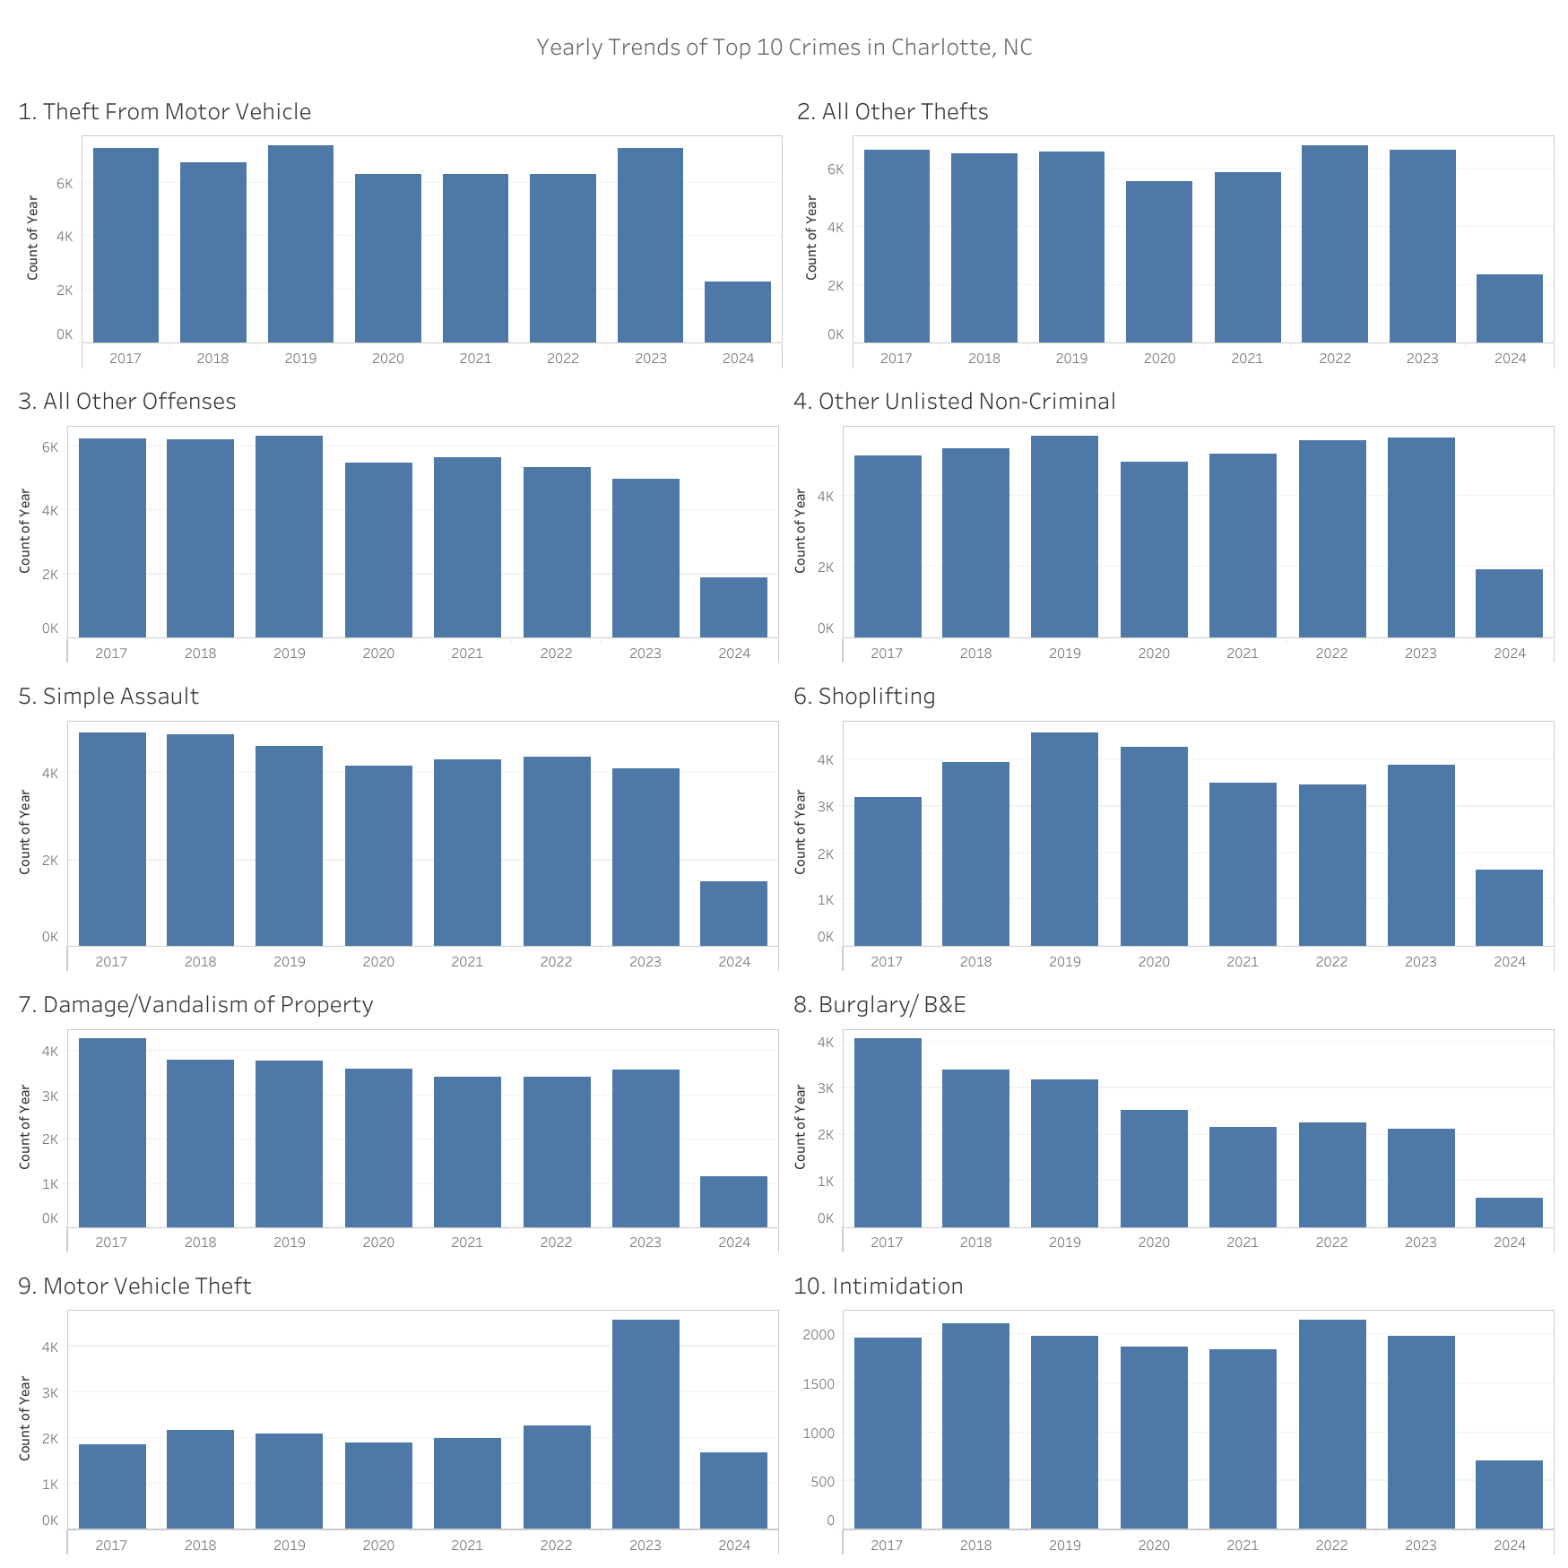
Click Here to View Full Dashboard
Notes:
Miranda

Slide 15
Pre-Optimized Model Results
Notes:
ZACH

Slide 16
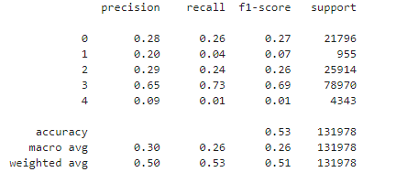
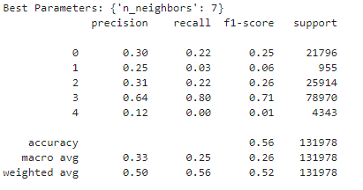
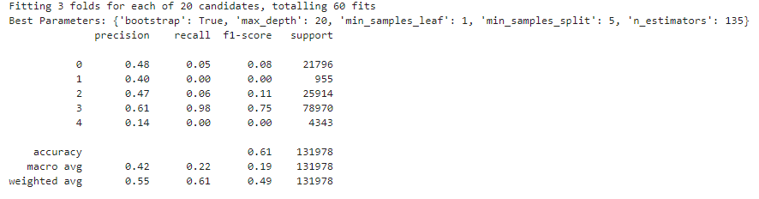
K Nearest Neighbors Model
KNN Process:
Dropped unnecessary columns to reduce noise and dimensionality in the dataset.
Used LabelEncoder to encode the target variable.
Used train_test_split to split the dataset into training and testing sets.
Standardized numerical features using StandardScaler.
Trained the KNeighborsClassifier model with n_neighbors=7.
Experimented with different values for the n_neighbors parameter in the KNeighborsClassifier model. Sometimes, a different number of neighbors can lead to better performance.
Notes:
ZACH

Slide 17
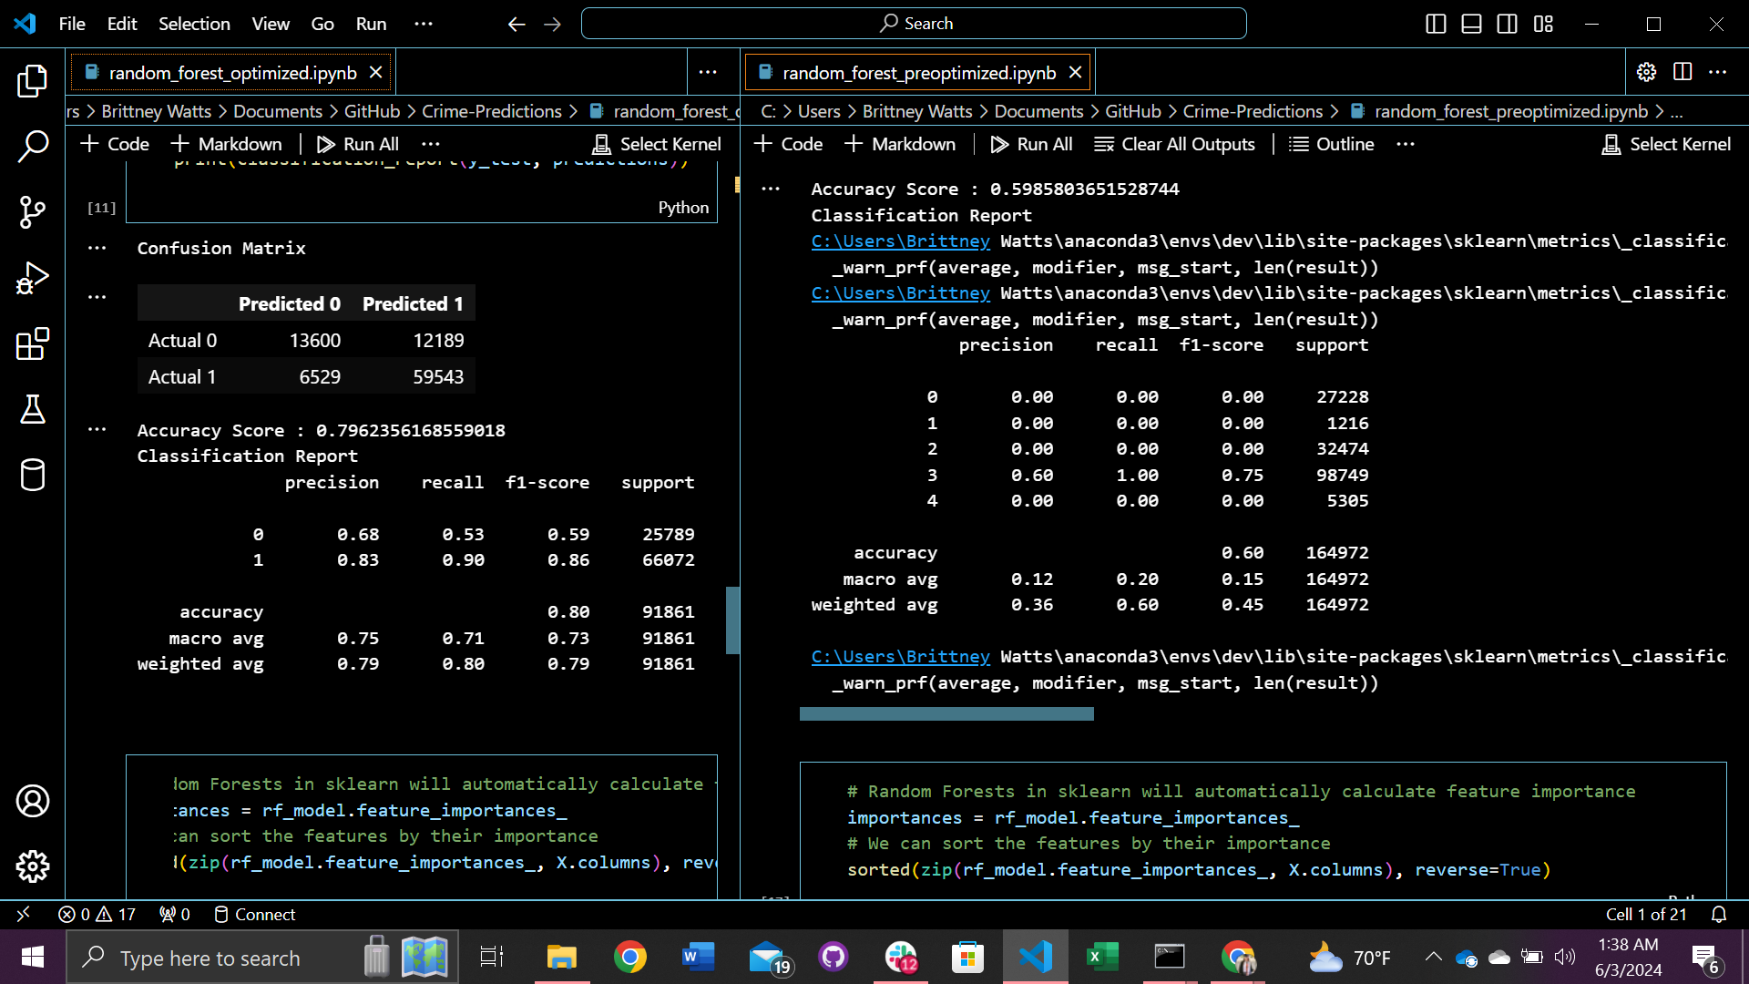
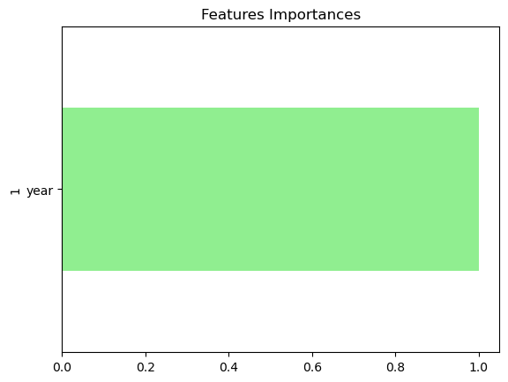
Pre-Optimized Random Forest Model
Created a connection to PostgreSQL to extract the data
Encode the variables using LabelEncoder and pd.get_dummies
Separate the features (X) and the target variable (y)
y = crime_data_df['clearance_status']
X = crime_data_df[['year', 'zip', 'division_id', 'npa', 'date_reported', 'place_detail_description', 'highest_nibrs_code']]
Use sklearn, split the dataset, instantiate a StandardScalar instance, fit the training data, and transform the data
Create a Random Forest Classifier, fit the model, make predictions from the data
Calculate the confusion matrix and accuracy score
Calculate feature importances from the Random Forest Model
Visualize the feature importances
RESULTS:
Only one feature was predicted for importance, year.
The target variable was not accurately represented by the model. Only “Open” clearance_status crimes were predicted.
This could be due to the imbalance classes, data issues, and the variability of the content within the features. E.g. ‘zip’, ‘date_reported’
Notes:
Brittney

Slide 18
Optimization Methods
Separate the ETL flow from the model notebook to improve memory.
Encode the data using OneHotEncoding and LabelEncoder and allow it to handle missing values.
Decrease the dimensions by:
Reduce the ‘clearance_status’ dimensionality by dropping unfounded clearance_status crimes and Use .loc to map all statuses to 'Cleared' except for 'Open'.
Dropping rows with values that are not necessary for the data i.e. dropping rows where there are less than 100 instances of ‘npa’ in the dataframe
Limit the categorical variable ‘date_reported’ to date/month values (just this reduced the dimensionality dramatically)
Remove values where ‘highest_nibrs_code’ was in the 800 category since these values correspond to non-criminal incidents.
Iterate through the dataframe to find nulls if any
WITHOUT SIGNIFICANT DATA LOSS, DIMENSIONALITY WAS REDUCED BY ~79%
Notes:
Brittney

Slide 19
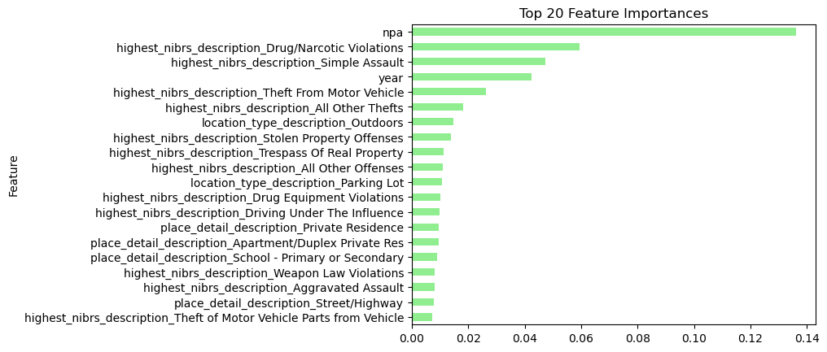
Feature Importances
Feature importance shows which features in the dataset have the most significant impact on predicting the target variable. Shown above is top 20 of 260.
Notes:
Brittney

Slide 20
Optimized Model Results
Notes:
Brittney

Slide 21
Classification Report
68% of the instances predicted as 0 are actually zero. 53% of the actual class 0 instances are correctly identified.
83% of the instances predicted as 1 are actually one. 90% of the actual class 1 instances are correctly identified.
f1-score = harmonic mean of precision
Accuracy = 80% of the instances were correctly predicted by the model
Overall, our model is 80% accurate and the weighted f-1 score is 0.79, indicating a good balance between precision and recall across the dataset.
0 - Cleared
1 - Open
Notes:
Brittney

Slide 22
Conclusions

Slide 23
Conclusions
Data Conclusions:
Thefts from a Motor Vehicle account for 49,901 offenses from 2017 and 2024
Nonviolent crimes account for 87% of the total crimes committed in Charlotte, NC from 2017 to 2024.
April 2020 saw the largest dip in nonviolent and violent crimes (likely attributed to COVID-19 lockdowns).
Most nonviolent and violent crimes occur in residential areas.
Motor vehicle theft saw a significant increase in 2023 compared to prior years with 4,559 offense.
Model Results:
The NPA (Neighborhood Profile Area) has the greatest effect on the crime predictions.
The model is significantly affected by drug and narcotic violations, simple assault, theft from motor vehicle, and all other thefts.
Year is the 4th highest predictor of crime.
Notes:
ZACH (top part), Brittney (bottom part)

Slide 24
Limitations/
Implications
Notes:
Miranda

Slide 25
Implications
Limitations
Bias with mapping NPAs (Neighborhood Profile Area)
Racial Bias (leads to discrimination and over-policing in areas/neighborhoods with more people of color)
Non-reporting bias (lack of accuracy)
Information is not specific enough and there is ambiguous data (e.g. 3 ‘catch-all’ categories)
Human-error in police reporting (misspellings, etc)
Law enforcement agencies can allocate resources to areas at higher risk of crime and take preventative measures to reduce crime rates.
Agency officials can make better-informed decisions by using machine learning models that analyze large volumes of data.
With this data, we could potentially analyze the crimes solved rate between states who use predictive policing and those who do not.
Notes:
Miranda

Slide 26
Questions?
Notes:
Miranda

